Slide 1

Know more
Do more
Be more
Welcome
Mr Tudor / Mr Cooper / Mr Bennett
The
Heath
Standard
Kindness, Integrity, Tenacity

Slide 2
Know more
Do more
Be more
Careers Advisor / CEIAG coordinator
Peter Reay
The
Heath
Standard
Kindness, Integrity, Tenacity

Slide 3
Know more
Do more
Careers Advisor / CEIAG coordinator
My Role
Conducting individual careers interviews Organising Year 10 work experience, including risk assessments Organising Year 11 mock interviews Organising careers conventions and events Collecting and collating student destination information Helping Year 11 students to apply to college / apprenticeships Identifying & supporting potential NEET students into positive outcomes Helping Year 9 students choose their GCSE options Anything else related to careers!
Be more
The
Heath
Standard
Kindness, Integrity, Tenacity

Slide 4
Know more
Do more
Careers Advisor / CEIAG coordinator
My background
25 years plus as a careers adviser in the North-West of England 15 years as a pub manager 5 years working at Butlin's as a Redcoat / Assistant Entertainments manager 2 years in prison!
Be more
The
Heath
Standard
Kindness, Integrity, Tenacity

Slide 5
Know more
Do more
Careers Advisor / CEIAG coordinator
Careers Programme
See: The Heath School Careers Programme 2023-2024
Be more
The
Heath
Standard
Kindness, Integrity, Tenacity

Slide 6
Know more
Do more
Careers Advisor / CEIAG coordinator
Options at 16
Go to college to take a range of A Levels (Cronton, Priestley or Sir John Deane's College) Go to college to take a vocational course (Riverside, Cronton, Warrington & Vale Royal or St Helens College) Start an apprenticeship
Be more
The
Heath
Standard
Kindness, Integrity, Tenacity

Slide 7
Know more
Do more
Careers Advisor / CEIAG coordinator
Heath School Destinations
See: The Heath School Year 11 Destinations 2024
Be more
The
Heath
Standard
Kindness, Integrity, Tenacity

Slide 8
Know more
Do more
Careers Advisor / CEIAG coordinator
What your children need to do
Work hard at their GCSE's especially English and Maths (plus Science if they want to do anything technical) Have good attendance and punctuality Volunteer to do things in school Get involved with activities outside of school Visit colleges on open evenings and apply to as many as they may want to go to If they would like an apprenticeship, apply to college in the Autumn term and then for apprenticeships from Christmas onwards Make the most of the help available in school, especially me!
Be more
The
Heath
Standard
Kindness, Integrity, Tenacity

Slide 9
Know more
Do more
Careers Advisor / CEIAG coordinator
Final Question
Any questions?
Be more
The
Heath
Standard
Kindness, Integrity, Tenacity

Slide 10
Know more
Do more
Be more
Assistant Principal - Curriculum
Mr Talbot
The
Heath
Standard
Kindness, Integrity, Tenacity

Slide 11
Know more
Do more
Mock exams
Dates
Monday 2nd December until Wednesday 18th December 2024
Be more
The
Heath
Standard
Kindness, Integrity, Tenacity

Slide 12
Know more
Do more
Mock exams
Why do we have them?
To ensure you know how to conduct yourself immediately before, during, and after the exam. To practice exam technique and timing To allow you to identify areas of strength and areas to address in revision To help provide estimated grades for colleges
Be more
The
Heath
Standard
Kindness, Integrity, Tenacity

Slide 13
Know more
Do more
Mock exams
What our students have to do (1/2)
Make sure you have the necessary equipment (BLACK biro, pencil, rubber, sharpener, ruler, scientific calculator, etc) in a clear pencil case. Water in a CLEAR bottle Make sure your phone/ (smart)watch is switched off (not just on silent)– you can hand this in to the exam invigilators when you enter the hall if you wish.
Be more
The
Heath
Standard
Kindness, Integrity, Tenacity

Slide 14

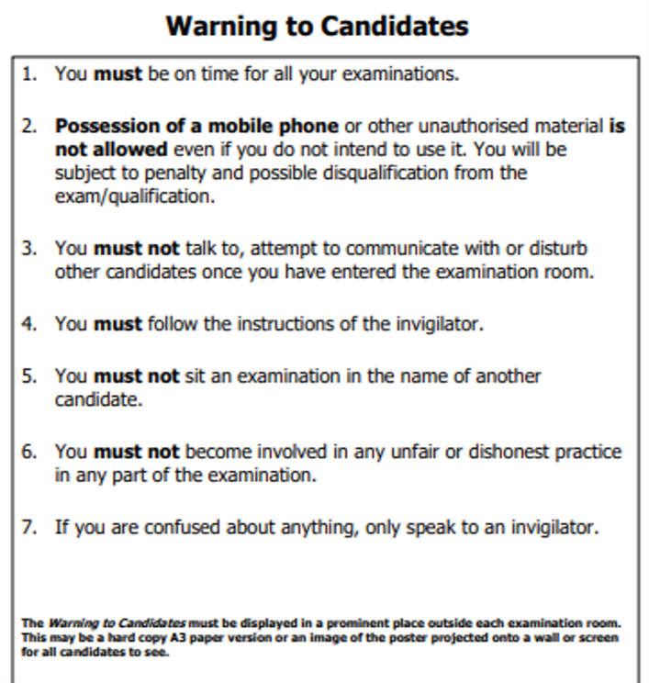
Know more
Do more
Mock exams
What our students have to do (2/2)
Make sure you know your room, seat row and number (displayed on the LRC window or outside the exam rooms) Line up on the MUGA in the correct row (or outside your exam room) at 8.45am/ 1.10pm Enter the hall in silence, leaving your bag at the side. When the exam time is over, leave in silence.
Be more
The
Heath
Standard
Kindness, Integrity, Tenacity

Slide 15
Know more
Do more
Mock exams
Exam Technique
Go to the toilet before lining up for the exam – you should not be going during the exam Watch the clock and pace yourself Read the questions carefully Underline/ highlight command words and key words Look at how many marks each question is worth Leave time to proofread. Any issues, hand up. Remain silent, facing forwards.
Be more
The
Heath
Standard
Kindness, Integrity, Tenacity

Slide 16
Know more
Do more
Mock exams
Timetable – Week One
Be more
Date | Morning – 9.00am | Afternoon – 13.20pm
Monday 2nd December | English Literature – 2h | Business Studies – 1h 45m Music extended lesson -2h (classroom)
Tuesday 3rd December | Biology Separate Science – 1h 45m Combined Trilogy – 1h 15m | History – 1h 45m
Wednesday 4th December | Maths P1 non-calculator – 1h 30m | Spanish/ French Reading H – 1h 15m Spanish/ French Reading F – 1h
Thursday 5th December | Chemistry Separate Science – 1h 45m Combined Trilogy – 1h 15m | Art – 3h (lesson 3 onwards) Textiles – 3h (lesson 3 onwards)
Friday 6th December | English Language – 1h 45m | RS – 1h Media – 1h 30m
The
Heath
Standard
Kindness, Integrity, Tenacity

Slide 17
Know more
Do more
Mock exams
Timetable – Week Two
Be more
Date | Morning – 9.00am | Afternoon – 13.20pm
Monday 9th December | Computer Science Comp 1 1h 30m | Geography – 1h 45m
Tuesday 10th December | Physics Separate Science – 1h 45m Combined Trilogy – 1h 15m | Photography – 3h (lesson 3 onwards) Drama extended lesson – 2h (classroom)
Wednesday 11th December | Child development 2h PE – 1h 30m | Maths P2 – 1h 30m
Thursday 12th December | Digital IT – 1h 30m (in IT Room S1) Animal Care – 2 h Dance extended lesson – 2 h | Computer Science Comp 2 – 2h (in IT room S2)
Friday 13th December | Engineering – 1h 15m Psychology – 1h 45m | Sociology – 1h 45m
The
Heath
Standard
Kindness, Integrity, Tenacity

Slide 18
Know more
Do more
Mock exams
Timetable – Week Three
Be more
Date | Morning – 9.00am | Afternoon – 13.20pm
Monday 16th December | RS – 1Hr Media - 1h 30m (in classroom) | Spanish/ French Writing H – 1h 15m Spanish/ French Writing F – 1h
Tuesday 17th December | Food Tech – 1h 45m | Art – 2h (classroom) Textiles – 2h (classroom)
Wednesday 18th December | Maths Paper 3 – 1 h 30m | Photography -2 h (classroom)
The
Heath
Standard
Kindness, Integrity, Tenacity

Slide 19
Know more
Do more
Mock exams
F.A.Q.’s
What if I have a clash (2 subjects I study on at the same time)? What if I don’t have an exam that day? What happens in the 3 hours slots for Art, Photography and Textiles?
Be more
The
Heath
Standard
Kindness, Integrity, Tenacity

Slide 20
Know more
Do more
Be more
Assistant Progress Coordinator
Mrs Jones
The
Heath
Standard
Kindness, Integrity, Tenacity

Slide 21
Know more
Do more
Attendance
Be more
The
Heath
Standard
Kindness, Integrity, Tenacity

Slide 22
Know more
Do more
Be more
Progress Coordinator
Mr Bennett
The
Heath
Standard
Kindness, Integrity, Tenacity

Slide 23
Know more
Do more
Calendar
Important Dates
Be more
Event | Dates
Mock exams | Monday 2nd – Wednesday 18th December
Mock Results Day | Friday 24th January
Year 11 Parents Evening | Thursday 6th February
Exam Dates | Thursday 8th May – Wednesday 18th June (+contingency week)
Leaver’s assembly | Thursday 26th June
Prom | Friday 4th July
Results Day | Thursday 21st August
The
Heath
Standard
Kindness, Integrity, Tenacity

Slide 24
Know more
Do more
Revision
What does it look like in school? (1/2)
A new system, implemented this year, following consultation with parents, is accessible to all students for core subjects, and targeted students for option subjects (subject to change) It is a two-week timetable of support offered after school every day, except Wednesdays. Over the year, 4 extra hours per week, for 25 weeks, gives a student 100 extra hours of study – equivalent to 4 weeks of school!
Be more
The
Heath
Standard
Kindness, Integrity, Tenacity

Slide 25
Know more
Do more
Revision
What does it look like in school? (2/2)
Some subjects are going further and offering sessions in form time/ lunchtimes /Wednesday after school (when they can)/ school holidays to specific students. A dedicated, passionate collection of staff, all of which have the same goal. Revision and study skill sessions due soon – delivered through Learn for Life days and PSHE sessions.
Be more
The
Heath
Standard
Kindness, Integrity, Tenacity

Slide 26
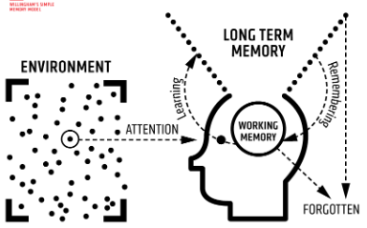
Know more
Do more
Revision
Why does it work? (The science!)
Be more
The
Heath
Standard
Kindness, Integrity, Tenacity

Slide 27
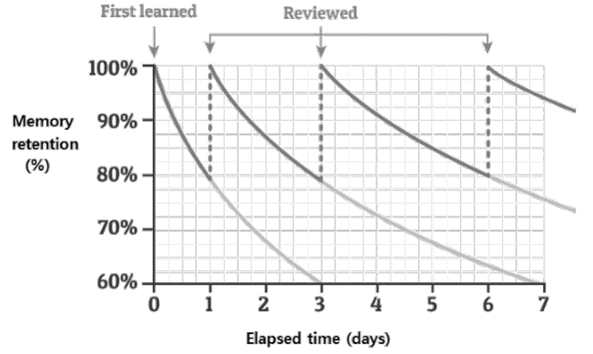
Know more
Do more
Revision
Why does it work? (The science!)
Be more
The
Heath
Standard
Kindness, Integrity, Tenacity

Slide 28
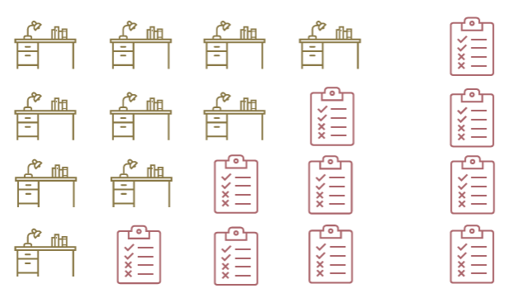
Know more
Do more
Revision
The process
Be more
The
Heath
Standard
Kindness, Integrity, Tenacity

Slide 29
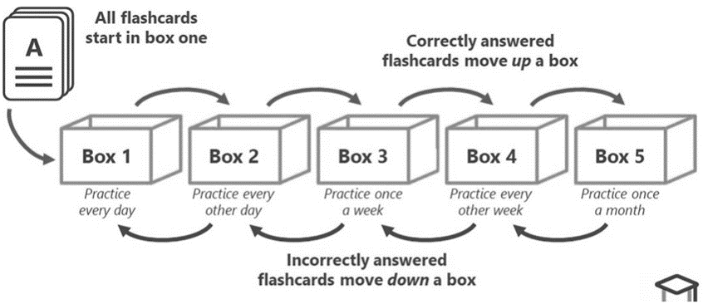
Know more
Do more
Revision
Revision techniques - Flashcards
Be more
The
Heath
Standard
Kindness, Integrity, Tenacity

Slide 30
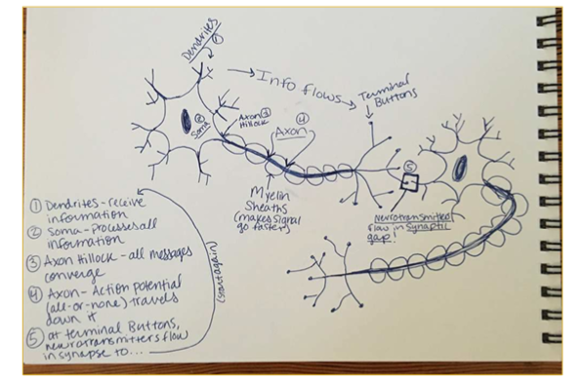
Know more
Do more
Revision
Revision techniques - Transform
Be more
The
Heath
Standard
Kindness, Integrity, Tenacity

Slide 31
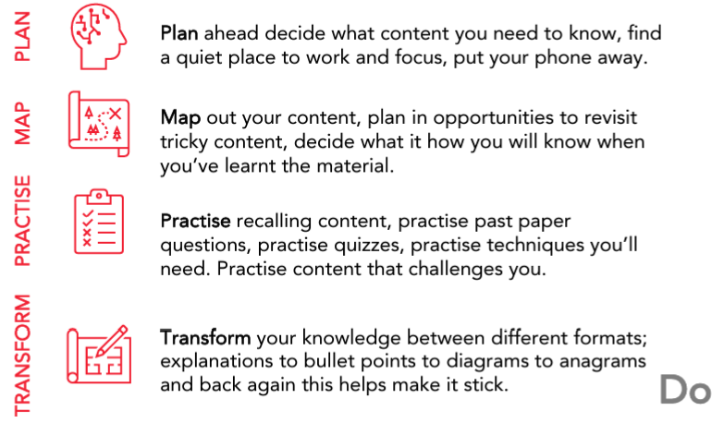
Know more
Do more
Revision
Revision - The Do’s
Be more
The
Heath
Standard
Kindness, Integrity, Tenacity

Slide 32
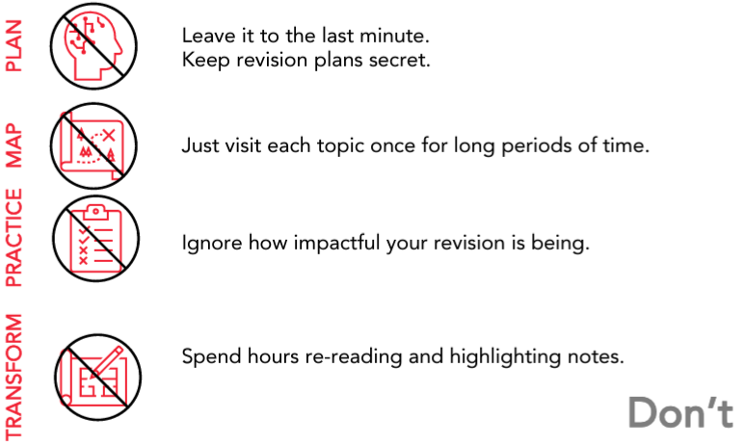
Know more
Do more
Revision
Revision - The Don’ts
Be more
The
Heath
Standard
Kindness, Integrity, Tenacity

Slide 33
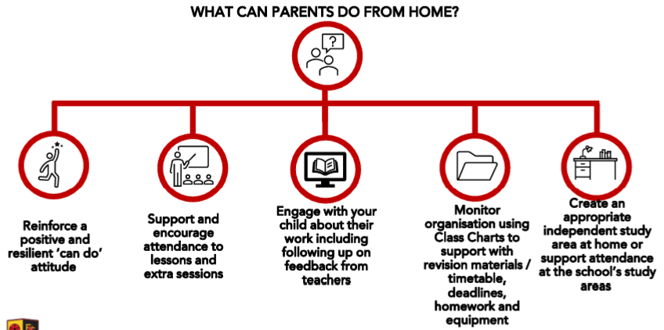
Know more
Do more
Revision
How can you help at home?
Be more
The
Heath
Standard
Kindness, Integrity, Tenacity

Slide 34
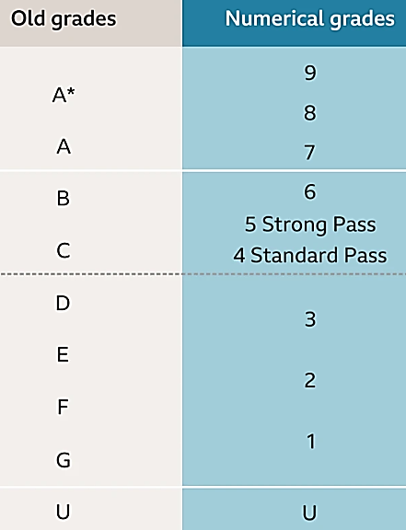
Know more
Do more
The grades
“What’s with all the numbers?!”
Be more
The
Heath
Standard
Kindness, Integrity, Tenacity

Slide 35
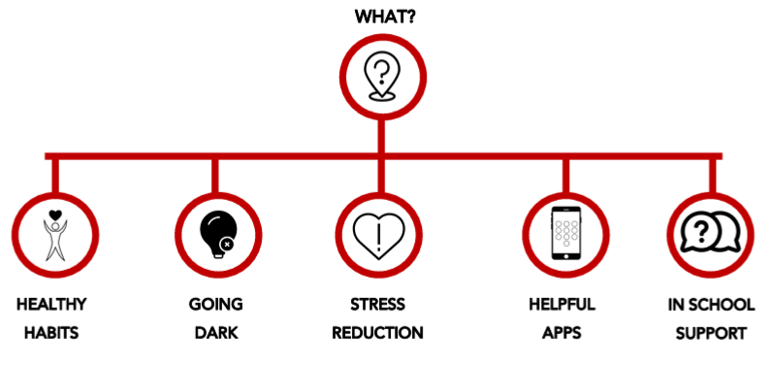
Know more
Do more
Student (and parent!) wellbeing
When the going gets tough….
Be more
The
Heath
Standard
Kindness, Integrity, Tenacity

Slide 36
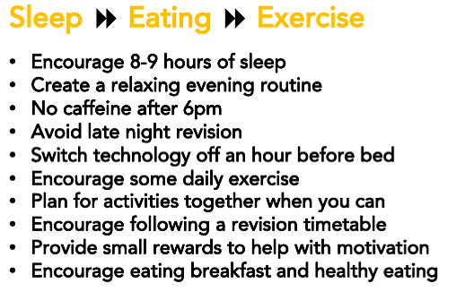
Know more
Do more
Student (and parent!) wellbeing
Healthy Habits
Be more
The
Heath
Standard
Kindness, Integrity, Tenacity

Slide 37
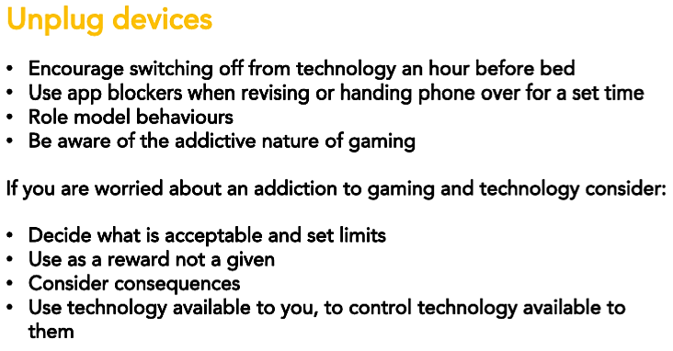
Know more
Do more
Student (and parent!) wellbeing
Going Dark
Be more
The
Heath
Standard
Kindness, Integrity, Tenacity

Slide 38
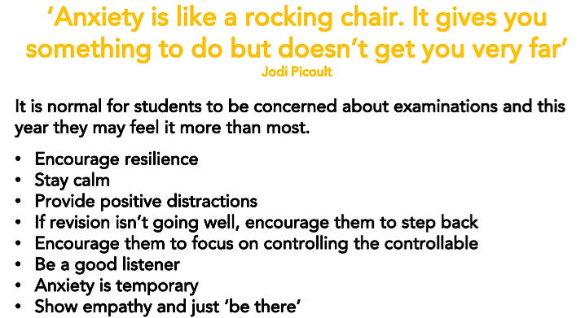
Know more
Do more
Student (and parent!) wellbeing
Stress Reduction
Be more
The
Heath
Standard
Kindness, Integrity, Tenacity

Slide 39
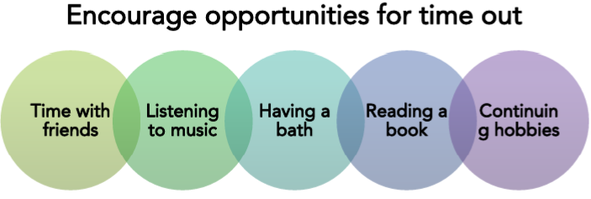
Know more
Do more
Student (and parent!) wellbeing
Stress Reduction
Be more
The
Heath
Standard
Kindness, Integrity, Tenacity

Slide 40





Know more
Do more
Student (and parent!) wellbeing
Helpful Apps
Be more
The
Heath
Standard
Kindness, Integrity, Tenacity

Slide 41
Know more
Do more
Student (and parent!) wellbeing
In-school support
Form Tutor Assistant Progress Coordinator Mrs Jones (the reason she joined the team!) Progress Coordinator Mr Bennett Safeguarding team Any trusted adult
Be more
The
Heath
Standard
Kindness, Integrity, Tenacity

Slide 42

Know more
Do more
Prom
Details
Friday 4th July 2025 Park Royal Hotel, Warrington Just off Junction 10 of M56 15 min drive £60pp Support available Letter coming asap!
Be more
The
Heath
Standard
Kindness, Integrity, Tenacity

Slide 43
Know more
Do more
Be more
Thank You
Teamwork makes the dream work!
The
Heath
Standard
Kindness, Integrity, Tenacity

